Slide 1

C# Project Presentation
On
Laborer Management System

Slide 2
Project Team Members :
1) Arpa Debi (19-40407-1)
2) Hasan Sanjary Islam (19-39589-1)
3) Nazmun Nahar Akhi (19-39821-1)
4) Rifatul Azim (19-39388-1)
5) Muhammad Shahriar Zaman (20-41840-1)

Slide 3
Project Objective:
Our project will provide an easy platform for company owners and Human Resources employees to employ laborers and recruit them into various projects.
Other than that customers will be able to hire laborers into their projects.

Slide 4
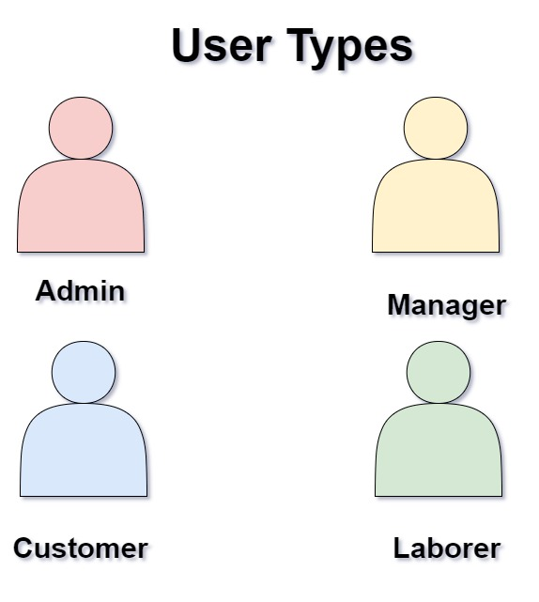
Project Details:
Our project will firstly have the following user types :
Admin
(Modifiying managers, Modifying customer balance, Manager Salary, Company Report)
Manager
(Approving Hiring, Modifying laborers, Withdrawing Salary)
Customer
(Hiring, Paying, Rating Laborers)
User Types

Slide 5
Main Menu

Slide 6
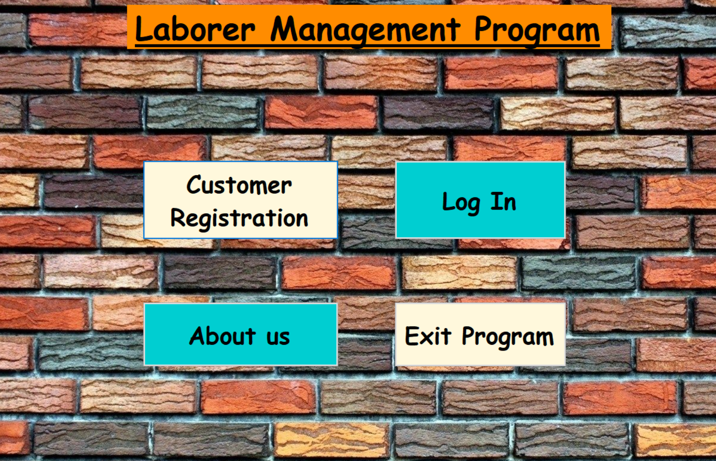
Fig : Main Menu of the Program

Slide 7
Customer Menu

Slide 8
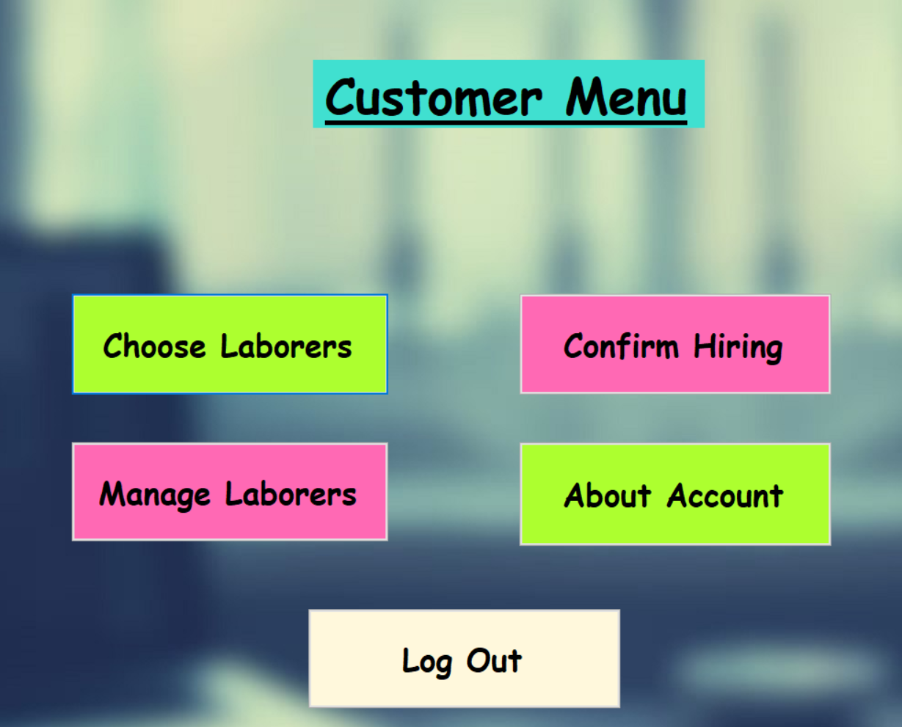
Fig : Customer Menu of the Program

Slide 9
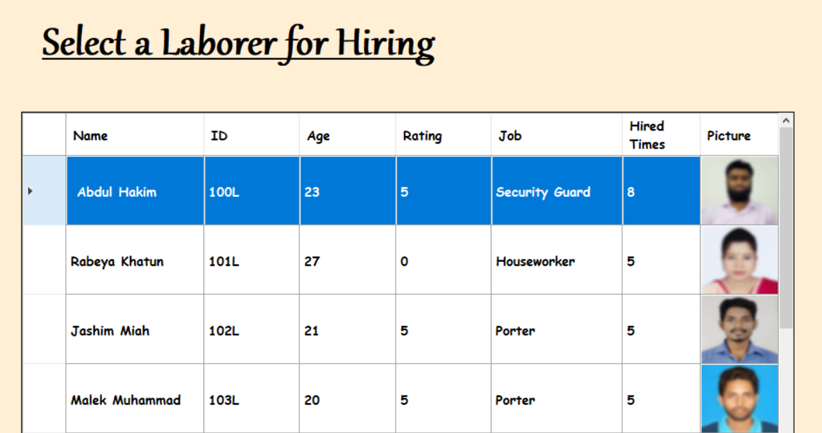
Fig : Customer selecting laborers to apply for

Slide 10
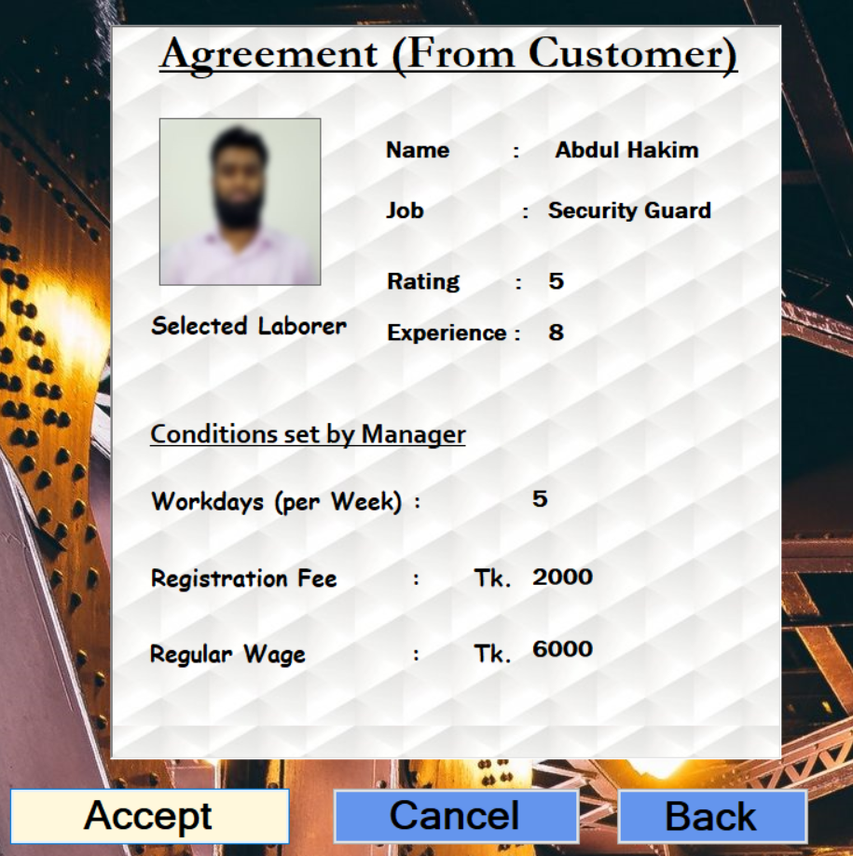
Fig : Customer confirming hiring
(After Manager sets the Conditions (Slides 14) )

Slide 11
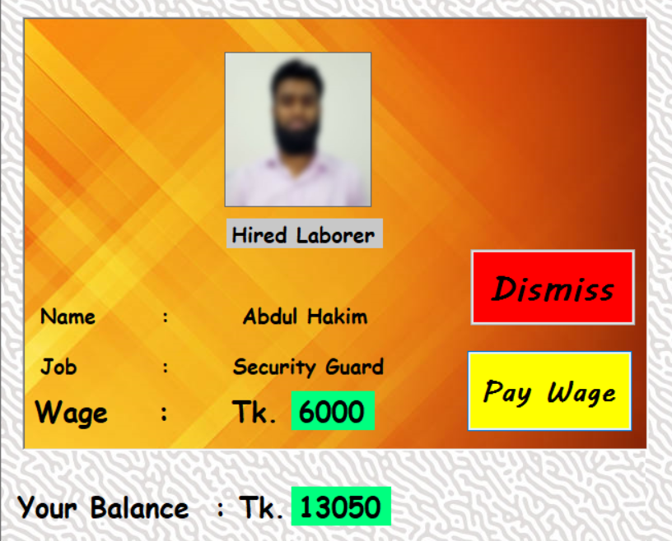
Fig : Customer paying wages to/dismissing the hired laborer

Slide 12
Manager Menu

Slide 13
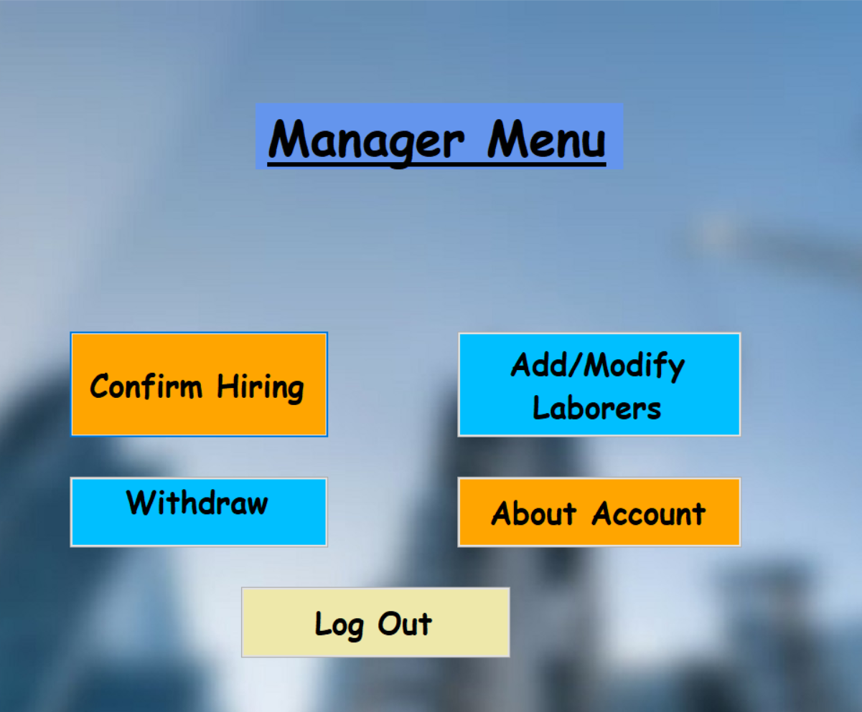
Fig : Manager Menu of the Program

Slide 14
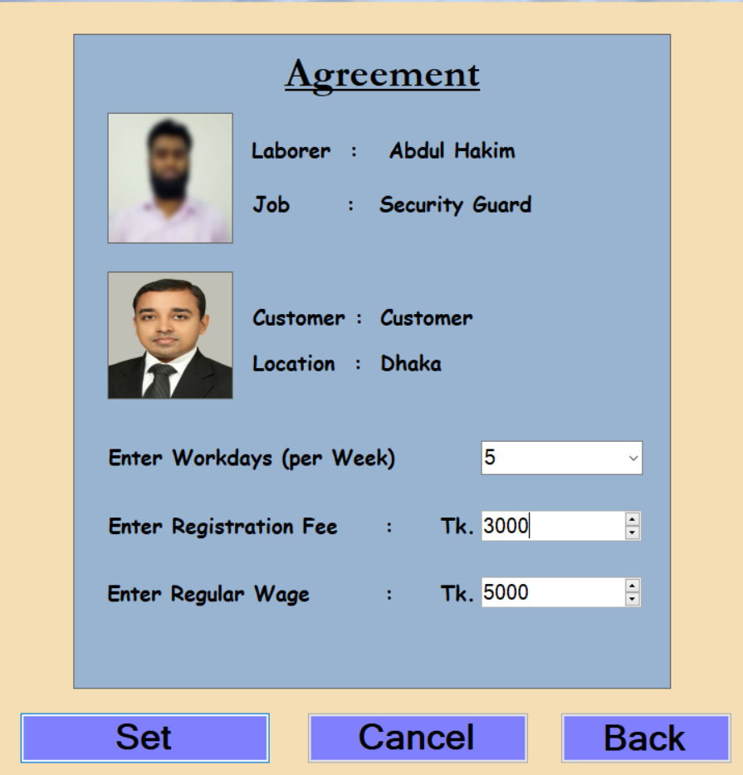
Fig : Manager Setting the conditions required for hiring.
The customer has to agree to these (Slide 10)

Slide 15
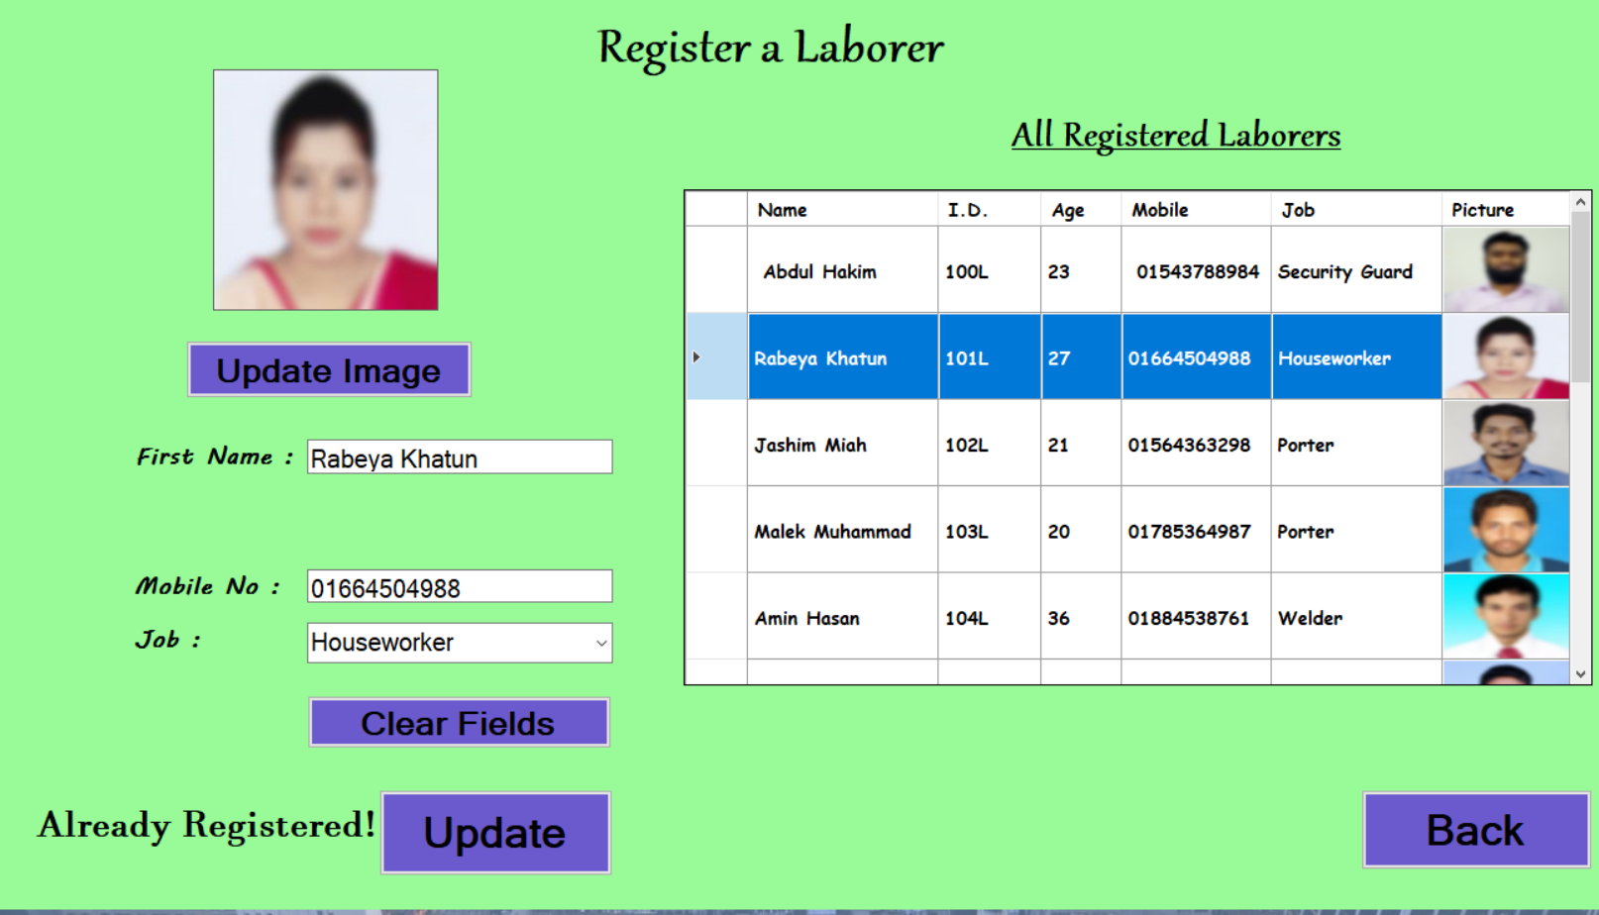
Fig : Manger registering/modifying laborers

Slide 16
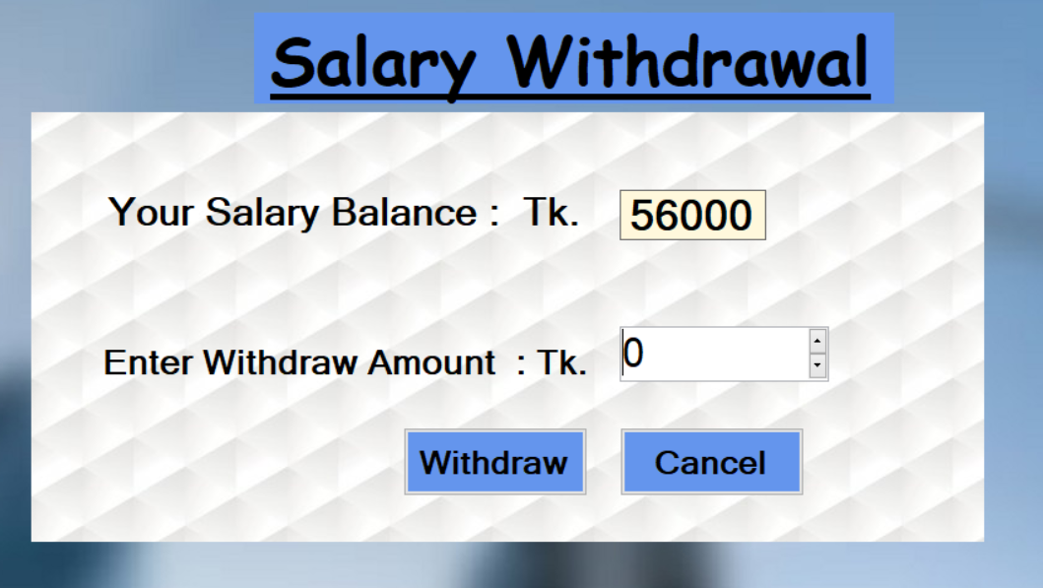
Fig : Manger withdrawing his/her Salary

Slide 17
Admin Menu

Slide 18
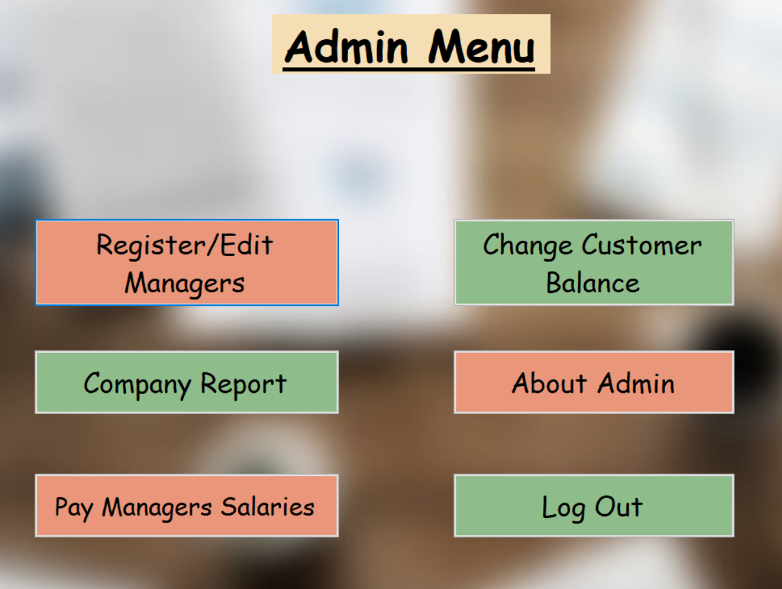
Fig : Admin Menu of the Program

Slide 19
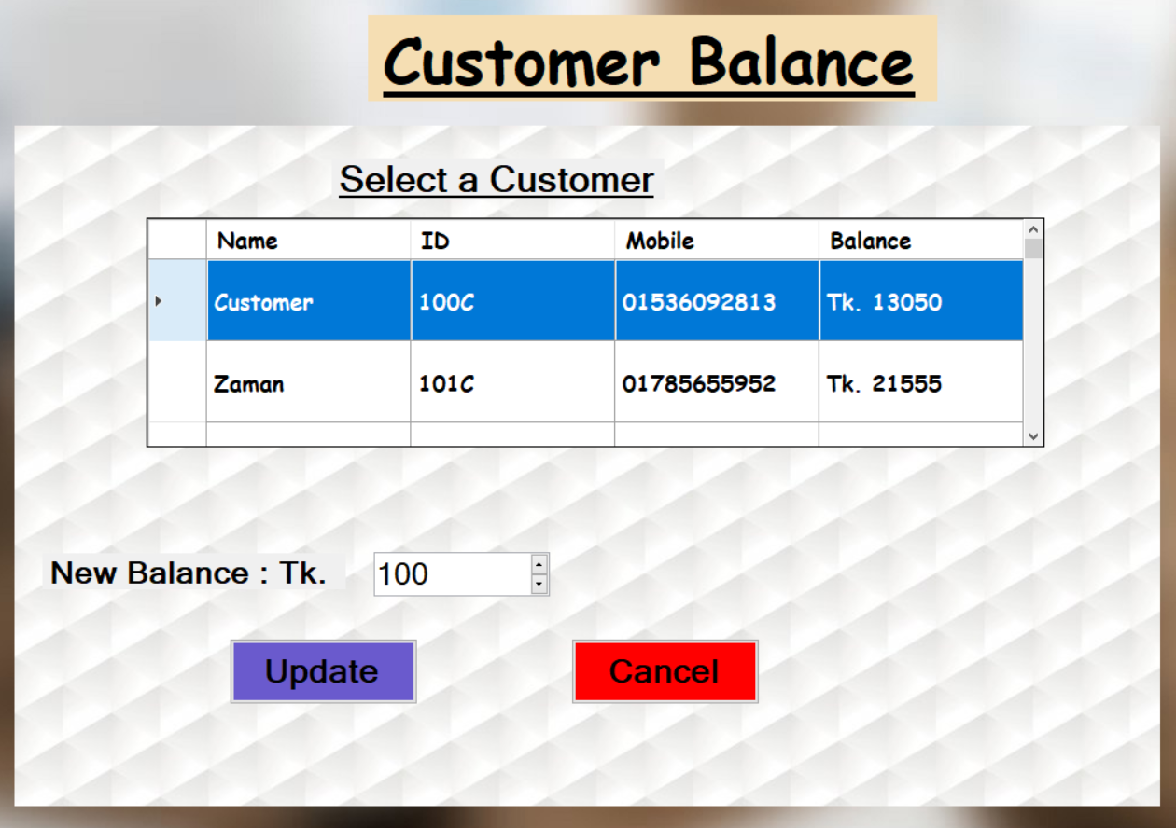
Fig : Admin changing Customer Balance

Slide 20
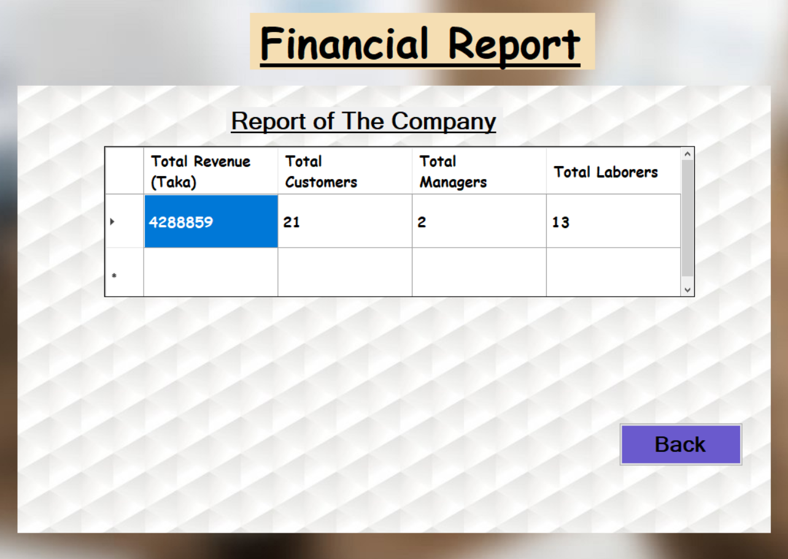
Fig : Admin viewing Company Report

Slide 21
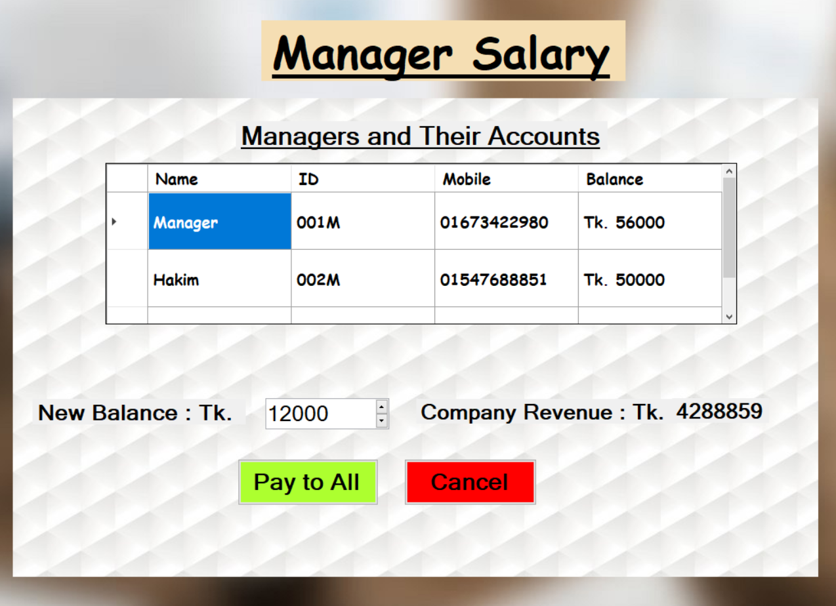
Fig : Admin paying Managers Salaries

Slide 22
About the Developers

Slide 23
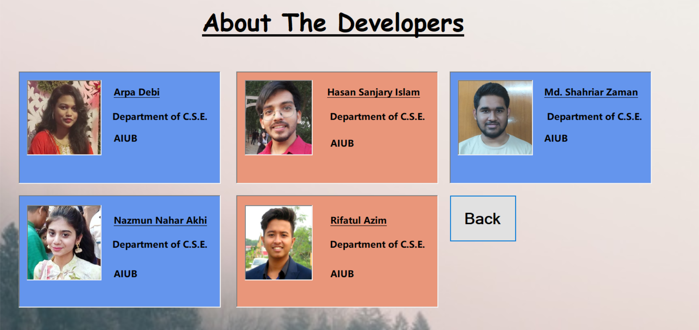
Fig : Basic information of the Developers

Slide 24
Limitations:
1) Managers, Customers and the Admin have to use the same copy of the program.
2) Lacks beautiful Animations. 3) No options provided for registering complaints to the Admin. 4) Managers don’t have specific regulations for setting hiring costs.

Slide 25
Contribution of Members :
1) Arpa Debi : Code writing and error fixing
2) Hasan Sanjary Islam : Code writing
3) Nazmun Nahar Akhi : Code writing
4) Rifatul Azim : Code writing
5) Muhammad Shahriar Zaman : Code writing and error fixing

Slide 26
Thank you
for your attention.

